Slide 1

REST way forward proposal
October 2017

Slide 2
Background
NEM service design has gone through an evolution from “IFW generated” to “Direct Design”
The initial approaches followed drove a level of complexity that continues to persist in NEM services despite a genuine desire for simplification.
There is also a directive from EA to move to REST.
In the meantime, projects/programmes such as Transform, EM4, and TSIP migration are unclear about whether to assume SOAP or REST.
Without clear direction they are opting for the status quo (SOAP, expanding existing services).
A move to REST would require a decision about the vocabulary / base models to use to design the data aspects of services.
We need to decide on tooling.
We need to understand the impact to in-flight projects if a change of direction is required.
This impact will be greater the longer we wait as older designs become ingrained beyond SO.
Now is the best opportunity to make a change.

Slide 3
Proposed Approach to the “Data Question”
The question “what should be the foundation of middleware data designs?” has been a source of lengthy, ongoing, theoretical debates. The proposed approach seeks to circumvent much of this.
Any complex problem is often best addressed by dividing into smaller problems.
The proposal is to divide the landscape of services into 5 domains:
Account
Payment
Product
InvolvedParty
Utility.
The first three of these are part of Open Banking, where questions around the REST data model and initial development approach have been addressed.
Although Open Banking is not yet live, the signs are that the approach followed is more efficient, and results in higher quality designs resulting in fewer defects.
Utility is a “catch-all” domain.
This leaves us with “InvolvedParty”.

Slide 4
Proposed Solution for “Involved Party”
The proposal is to create an initial prototype swagger specification of a GET nem/InvolvedParty/{InvolvedPartyID} operation.
We use “Direct Design” (see reference)
We agree this design with key stakeholders
The data represented by this operation is expected to largely be a superset of the data required by other InvolvedParty operations. It can therefore form an example for these.
For further illustration, we’ve added a POST /InvolvedParty service to create an InvolvedParty as well.
Design inputs:
The existing InvolvedPartyManagement SOAP service design (EM2 Day 1 version)
The CIS interface called by the existing InvolvedPartyManagement service

Slide 5
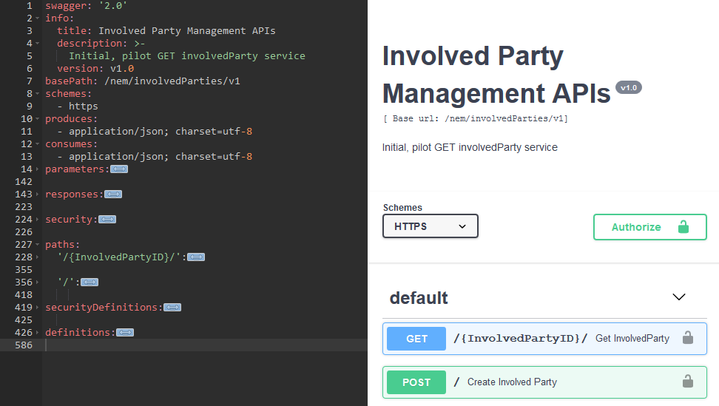
InvolvedParty Swagger Prototype

Slide 6
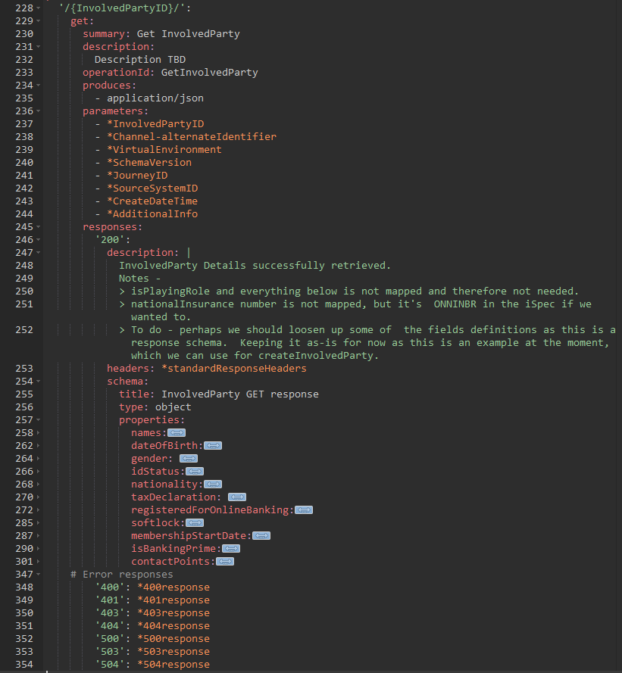
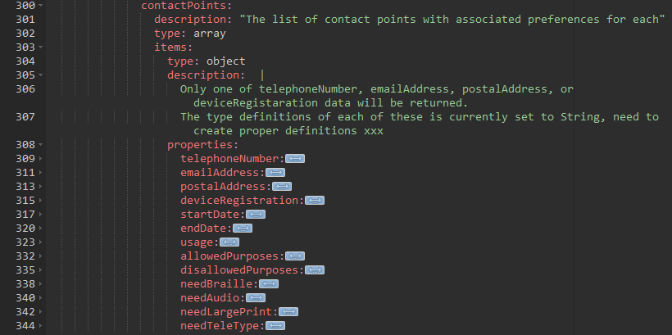
GET /nem/InvolvedParties/v1/{InvolvedPartyID}

Slide 7
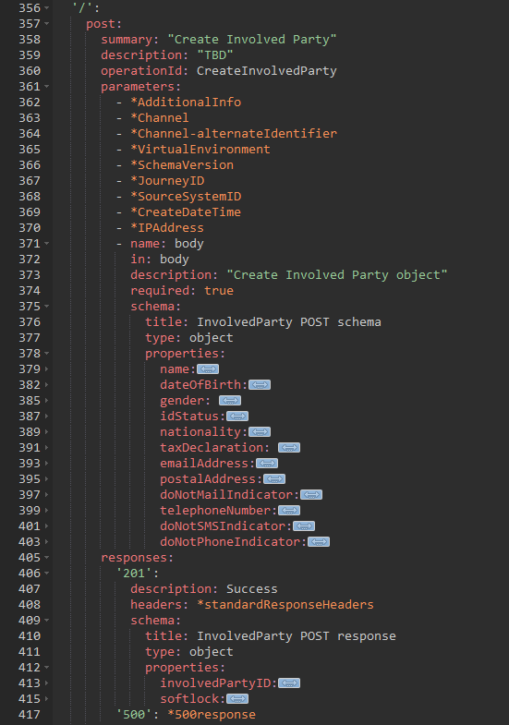
POST /nem/InvolvedParties/v1/

Slide 8
Swagger spec

Slide 9
Tooling
Open Banking used a local install of editor.swagger.io to create Swagger specifications.
The Involved Party prototype was created using the same tool.
RSA version 9.6 supports Swagger production. We should seek to use this once rolled out. (Project started)
RSA v9.6 is able to ingest existing Swagger specs. When this is done we can link data elements to foundation models (BOM) if desired.
In the meantime, editor.swagger.io, when installed locally in NBS, is sufficient, but we need to assess scaling impact.
Furthermore:
Tooling should not get in the way of what you’re trying to achieve: clear, easy to understand, Swagger specs.
Using a direct editor for the time being has a significant positive side-effect that designers become intimately familiar with the output they’re meant to create (as opposed to this being hidden through abstract models).

Slide 10
Implications
Transform and EM4 are currently designing using SOAP.
A change in direction requires an impact assessment.
The longer we wait, the larger the impact.
Note: service gateway will become the default, allowing designs to evolve while reducing “versioning” impact.

Slide 11
Reference
NEM Service Design Past, Present, Future http://mynationwideteam/sites/nbs_eprise_mware_dc/Solution/Solution%20Engineering%20Working%20folder/REST/New%20NEM%20Service%20Design%20-%20Past,%20Present,%20Future%20(July%202016).pptx

